Slide 1
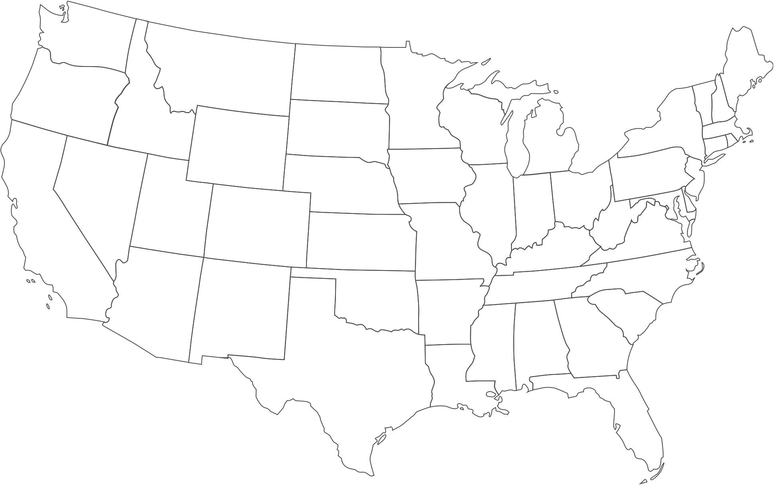




Slide 2
The Severity of the Problem
For the first time, in 2021, it was estimated that over 100,000 persons died of a drug-related death
This is only the number of deaths and does not capture the number of persons who overdosed or the number of persons who currently use/misuse drugs
This is not a new epidemic; it continues to change over time
Notes:
https://www.cdc.gov/nchs/nvss/vsrr/drug-overdose-data.htm

Slide 3
The Continued Rise of Fentanyl Related Deaths

Slide 4

Real-time Public Health and Safety Data Collaboration
Public health data/solutions alone cannot “solve” the current epidemic
Public safety data/solutions alone cannot “solve” the current epidemic
Retroactive data alone cannot drive life-saving decisions
Collaboration and real-time data helps save lives and drive short and long-term decisions

Slide 5
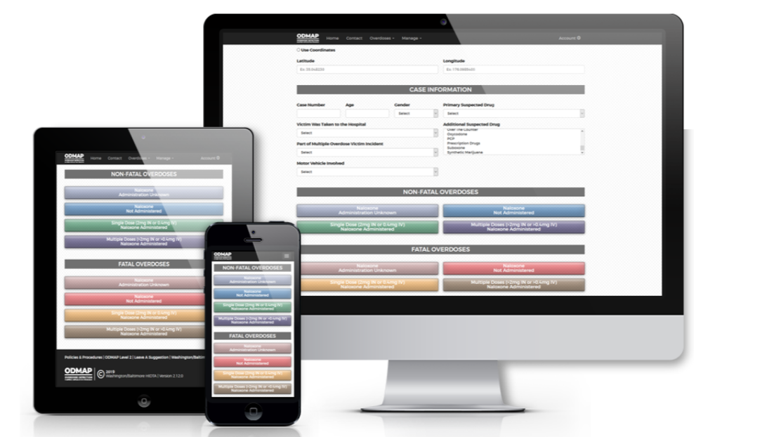
What is ODMAP?
ODMAP is a free, web-based tool that provides near real-time surveillance of suspected overdose events to support public safety and public health efforts to mobilize an immediate response to overdose events
Notes:
ODMAP Overview video: https://www.youtube.com/watch?v=KjSMlpXxhYc
ODMAP Resource Page: https://odmap.org:4443/Resources

Slide 6
Current ODMAP Engagement (May 2023)
Number of participating states: 50, DC, and Puerto Rico
Number of participating agencies: approx. 4,450
Number of ODMAP users: approx. 29,000
Number of states with statewide implementation: 30
Number of suspected overdoses entered: over 1.86 million
Notes:
Statewide Implementation Overview: https://odmap.org:4443/Content/docs/ODMAP-State-Implementation-Still.pdf

Slide 7
ODMAP 101
How to engage with and use ODMAP

Slide 8
ODMAP Agency Eligibility
  Federal, State, Local, and Tribal
    Law Enforcement/Criminal Justice Personnel (including medical examiners/coroners)
    Public Health Personnel
  Licensed First Responders (Fire/EMS)
  Hospitals with Emergency Departments
    Excludes associated researched units commonly seen with universities
  All agencies must sign a Participation Agreement prior to gaining access, it outlines the ODMAP Policies and Procedures
Notes:
Becoming an ODMAP Agency explainer: https://www.youtube.com/watch?v=dZS9Ogg3Bzo
Requesting access to ODMAP technical video: https://www.youtube.com/watch?v=MKWxSsKLH-g
Requesting access to ODMAP form: https://odmap.org:4443/AgencyAccess/RequestForm

Slide 9
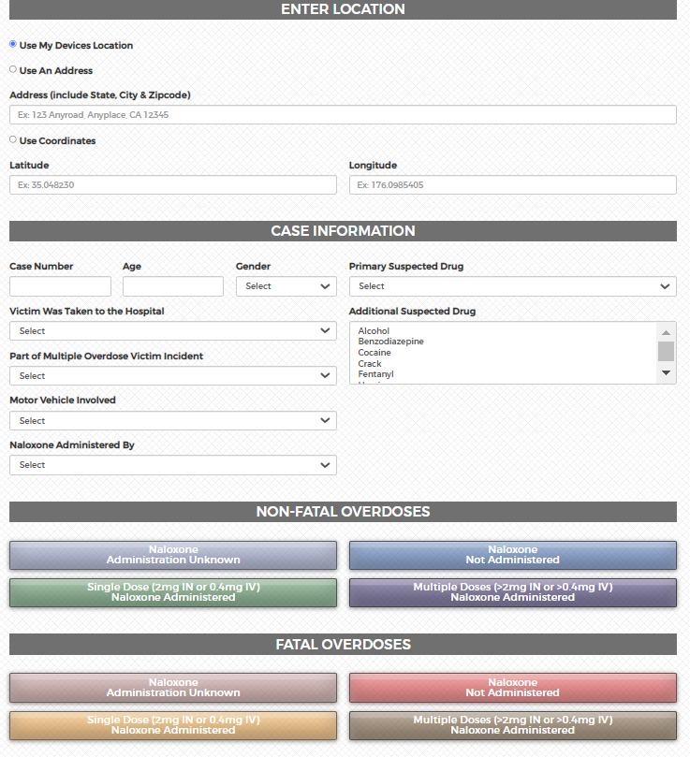
Overdose Event Data Entry Methods
Suspected overdose cases can be entered into the ODMAP system in three ways:
  Manual entry through the secure website (ODMAP is mobile friendly)
  ODFORM (for Case Explorer Users)
  Application Programming Interface (API)
Notes:
Entering ODMAP data technical video: https://youtu.be/C-FIkhFhBWs

Slide 10
Overdose Event Data Points Collected by ODMAP
Each case entry must include:
  Date and Time
  Location
  Outcome (fatal/non-fatal)
  Naloxone Administration
Agencies can add additional information, including (but not limited to):
  Suspected drug
  Transported to hospital
  Naloxone left behind by

Slide 11
Real-time Data Collection through APIs
An API allows for the direct, automated integration of the two software systems
ODMAP utilizes a REST (Representational State Transfer) API, combined with a JSON payload to transfer data between both systems
This is a combination of modern technology that is developer friendly and compatible with nearly all programming languages
The API requires some set up at the beginning but does not require any changes to an agencies current data entry protocol
Notes:
ODMAP API Guidance: https://odmap.org:4443/Content/docs/training/general-info/ODMAP-API-Guidance.pdf

Slide 12
ODMAP and HIPAA
ODMAP is not considered a “system of record” – it collects location, date/time, fatality status, and naloxone administration
        The information captured by ODMAP is not considered PHI - the location is translated into a geo-located point where an overdose occurred without any other information about a person
        W/B HIDTA and ODMAP do not retain any address information within the platform or on the server (they are deleted)
        ODMAP Zoom function is restricted to a zoom Level ID: 15 (scale of 1:18055.95)
Notes:
See our ODMAP and HIPAA Guidance Document here: https://odmap.org:4443/Content/docs/ODMAP-and-Protected-Health-Information-Under-HIPAA-Guidance-Document.pdf

Slide 13
Sharing Data with ODMAP
ODMAP is a Data Steward, it does not own the data submitted by agencies
All ODMAP agencies sign a Participation Agreement outlining the data sharing practices and limitations
Raw data cannot be downloaded or shared, unless an MOU is signed, or the submitting agency shares the information
Notes:
See the ODMAP Data Sharing one-pager here: https://odmap.org:4443/Content/docs/ODMAP-Data-Sharing-Overview.pdf

Slide 14
ODMAP Tools
The National Map and Spike Alerts

Slide 15
ODMAP Features
ODMAP National Map
  Cross jurisdiction suspected event information
  Filters
  Heat maps
  Charts
Spike, Overdose, and Statewide Alerts
Adding personal data and Esri web layers
Multiple agencies providing data for areas, capturing more suspected events

Slide 16
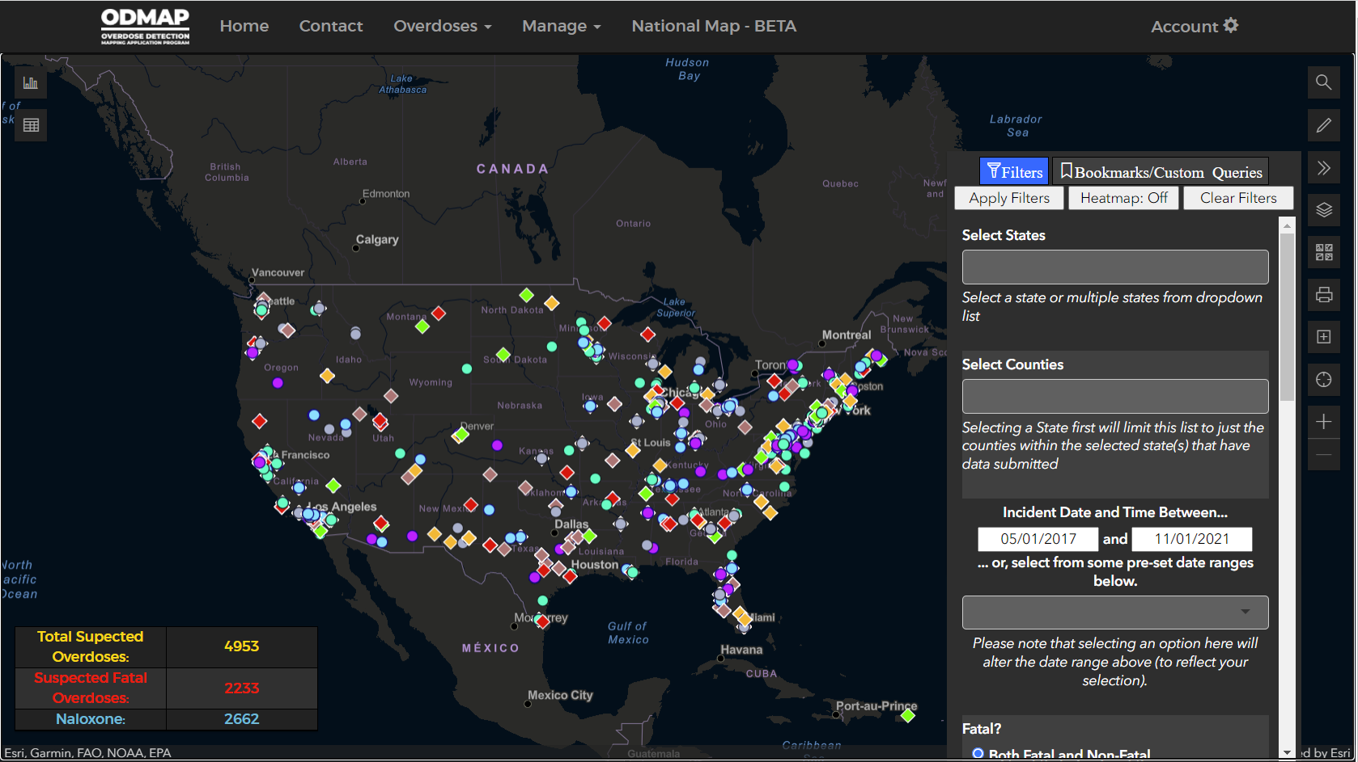
National Map and Its Features
Notes:
Learn more about the National Map here: https://youtu.be/_qLwAMMjo0k

Slide 17
National Map and It’s Features

Slide 18
Default 24-hour summary statistics

Slide 19
Built-in filters to do deep dives into ODMAP data, including:
Date and times
Location
Type of drug

Slide 20
View the map legend
Change the look of the map
Print your Map
Add your own data or ESRi Layer

Slide 21
Built-in charts, including:
Type
Day of Week
Hour of Day
By day
By month
Multiple county/state line chart
Grid for reviewing overdose information

Slide 22
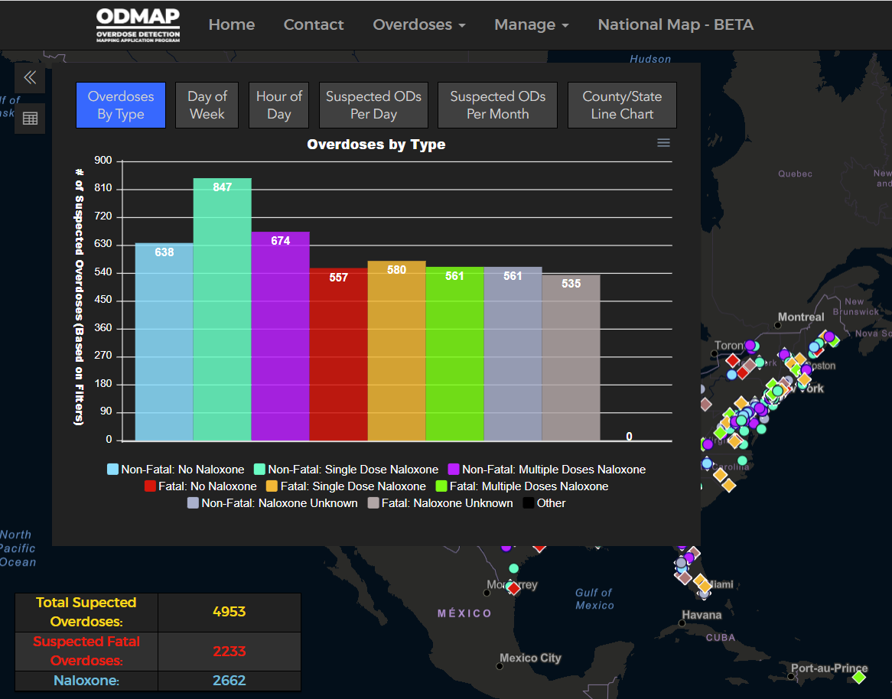

Slide 23
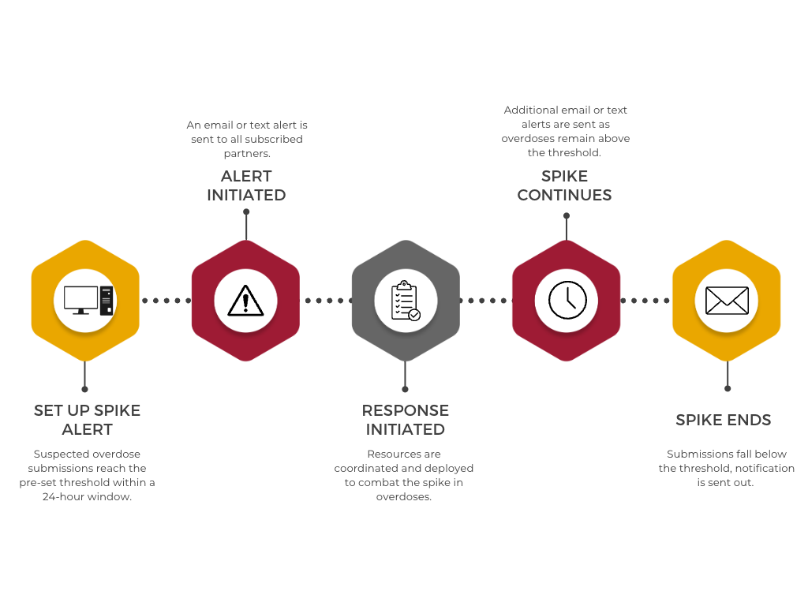
Spike Alert Process

Slide 24

How Spike Alerts Work
Notes:
You can find the video here: https://youtu.be/moKoyAt1pCk

Slide 25
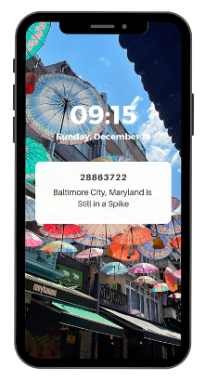
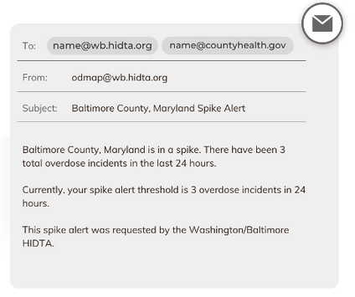
Spike Alert Formats

Slide 26
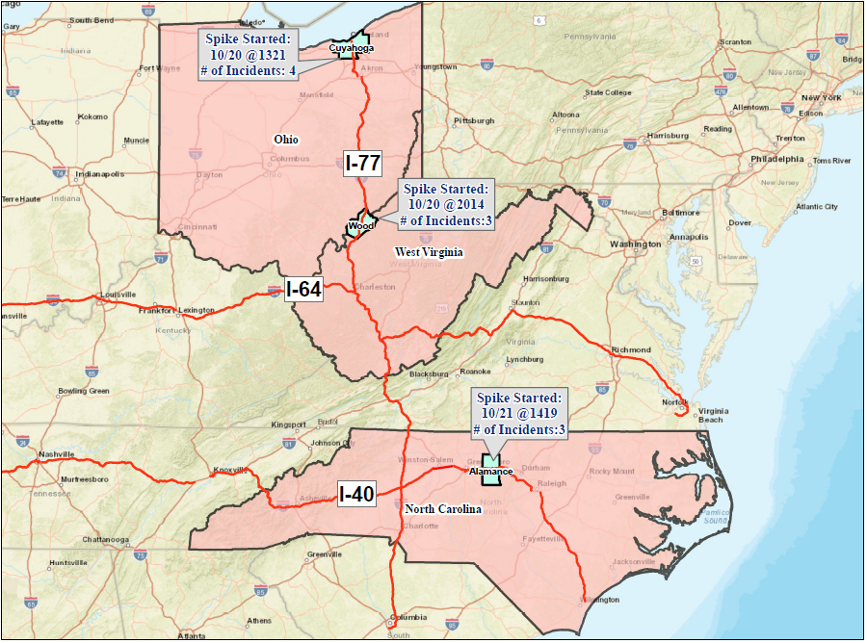
Spike Alert Analysis: I - 77
October 20th – October 21st
Cuyahoga County, OH
Spike Started: 10/20 at 1321, 4 Overdoses
Wood County, WV
Spike Started: 10/20 at 2014, 3 Overdoses
California to Midwest April 7th – April 12th
ALAMANCE, NC
Spike Started: 10/21 at 1419, 3 Overdoses
Notes:
Interstate 77 connects Cleveland to Columbia, South Carolina, traversing, West Virginia, and Charlotte, North Carolina

Slide 27
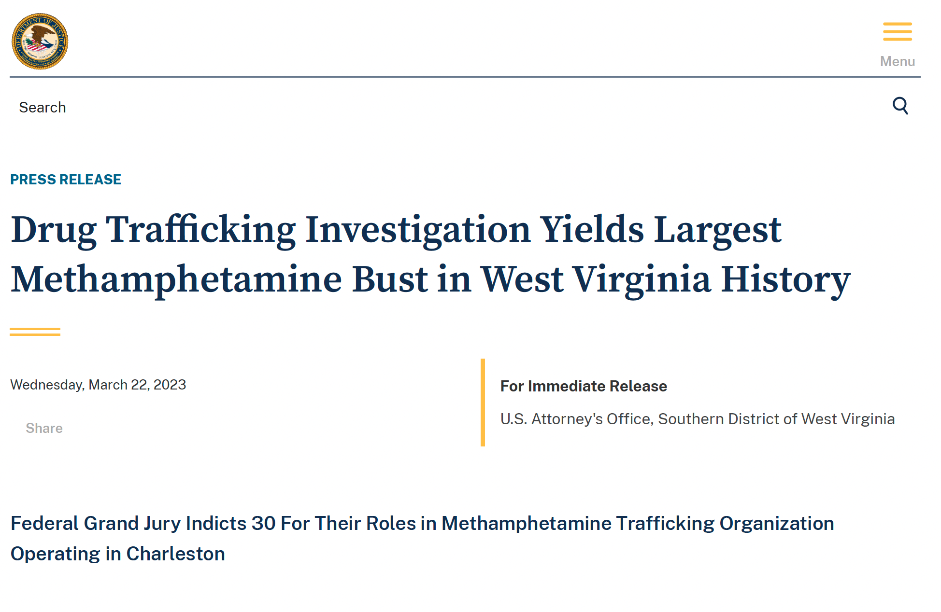
Operation Smoke and Mirrors
On March of 2023, the Department of Justice’s Organized Crime Drug Enforcement Task Force (OCDETF) conducted an investigation that led to a significant drug seizure in the Charleston area. “Operation Smoke and Mirrors” led to 54 arrests and over 200 pounds of methamphetamine and 28 pounds of cocaine being seized. In addition, officials seized 20 pounds of fentanyl, which represents more than 4.5 million lethal doses.
Notes:
The “Operation Smoke and Mirrors” had a significant impact on drug overdoses in the Charleston area. Overdoses decreased by 91 percent in March of 2023, when compared to the same time last year.

Slide 28
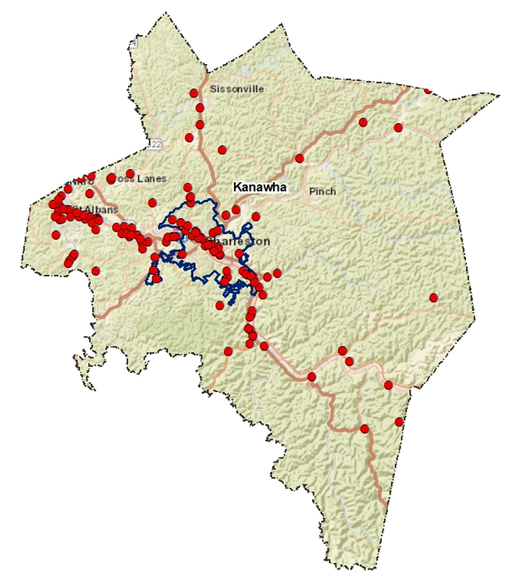
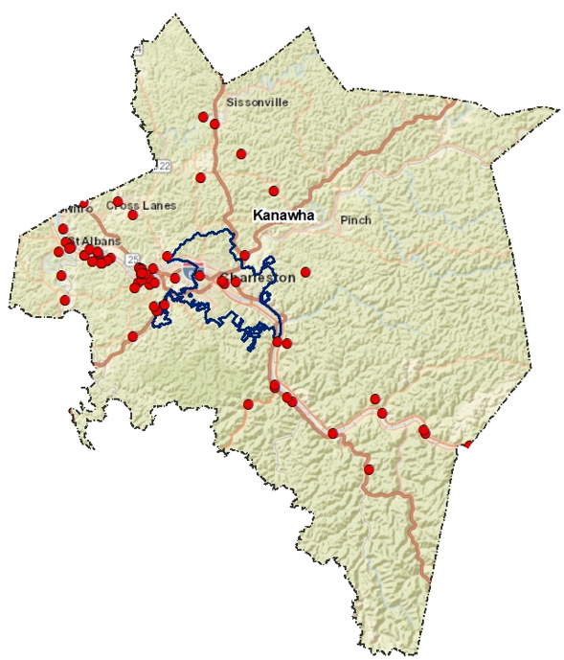
Operation Smoke and Mirrors Impact on Kanawha County, WV
“Operation Smoke and Mirrors” had a significant impact on drug overdoses in the Charleston area. Overdoses decreased by 91 percent in March of 2023, when compared to the same time last year.
March 1 – March 31, 2022
March 1 – March 31, 2023
Notes:
Data seen on ODMAP

Slide 29
ODMAP in the Field
How do Agencies Use the Data in ODMAP to Drive Decisions

Slide 30
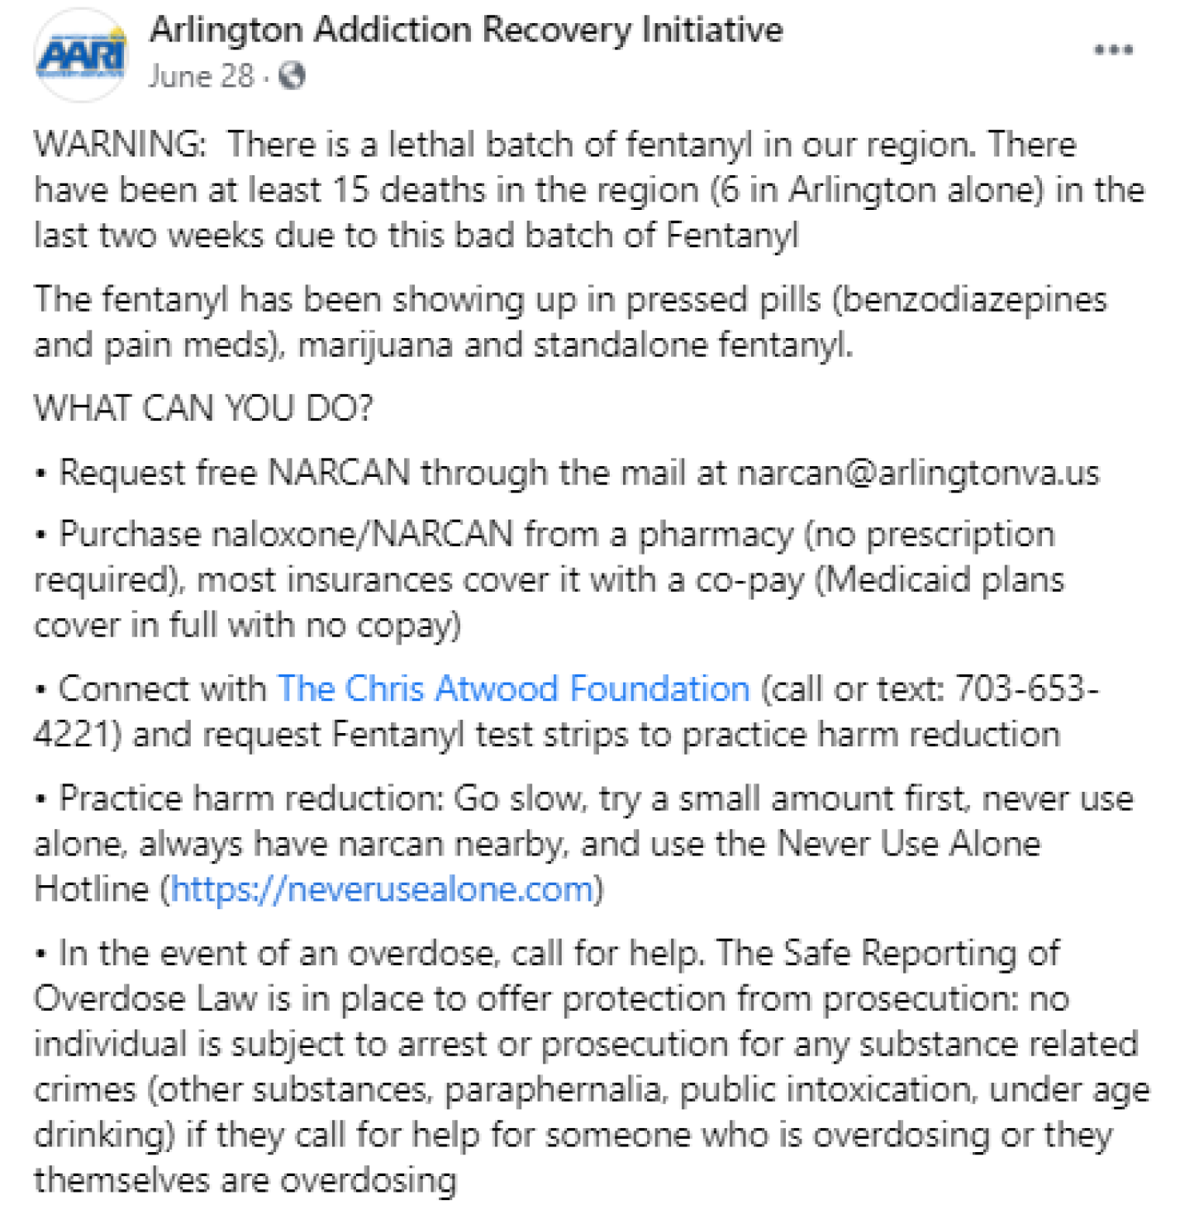
Spike Alerts in the Field: Arlington County, VA
On June 28, 2021, a spike alert was triggered for Arlington County, Virginia
Public safety and health officials reached out to neighboring counties to identify scope of the spike
Two other Northern Virginia counties reported higher than normal overdoses over the past weekend
Arlington County stakeholders drafted a community alert and posted information on their coalition Facebook page, it included:
  Information on the presence of Fentanyl
  ^{Local resources}
  Information on the local Safe Reporting of an Overdose Law
Notes:
Social media quick guide: https://odmap.org:4443/Content/docs/ODMAP-Social-Media-Quick-Guide.pdf
Social media quick guide webinar: https://youtu.be/v9lg4DWZVDw

Slide 31
Spike Alert Response Teams/Protocols
Agencies create a tailored spike response program to ensure there is a quick response to increases or spikes in overdoses
Should include public health, law enforcement, EMS, hospitals, and adjacent agencies (i.e. medical examiners/coroners and hospitals)
Can set up spikes for any threshold on ODMAP, so agencies can be alerted based on their agency's prevention/response program

Slide 32

Outreach Teams
Agencies can use ODMAP to identify cases in their specified jurisdiction
Once an overdose is identified, they will connect with the reporting agency and implement their follow-up protocol
Specific case information comes from the agency itself, not ODMAP

